Slide 1

Sentiment Analysis Model Based on Twitter Comments
Guo Kaihua (G2304650E)
Ren Xiao (G2405573L)
Zhao Xiajing (G2406086D)
Zhou Gaoqiang (G2304064A)
AiPPT
202X.X

Slide 2
Introduction
Objective: Build and compare ML & DL models for Twitter sentiment analysis.
Definition of Sentiment Analysis
01
Detects emotional tone in user-generated content.
Why Twitter
02
Provides short, real-time, and unstructured data ideal for sentiment analysis.

Slide 3
Approach
Data Preparation
01
Clean and prepare Twitter dataset.
Model Development
02
Build and compare ML, DL, and Pretrained models.
Evaluation Goals
03
Evaluate using accuracy, F1 score, recall.

Slide 4

01
PART
Dataset Preparation

Slide 5
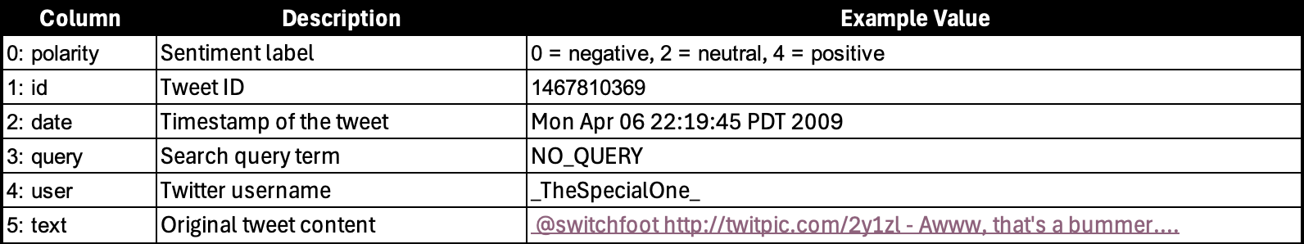
Dataset Overview
01.
02.
Dataset Source
Sentiment Classification
Kaggle Twitter Sentiment Dataset (1.6M tweets)
Binary sentiment Positive (1), Negative (0)

Slide 6
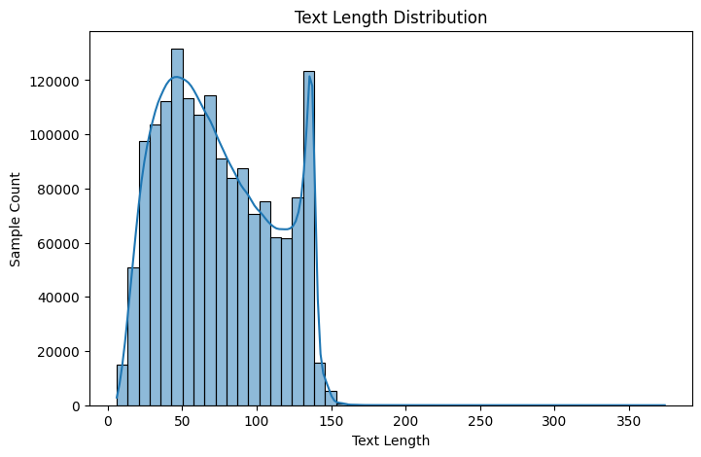
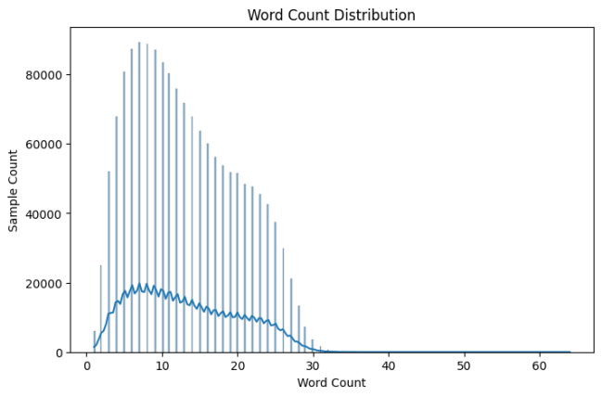
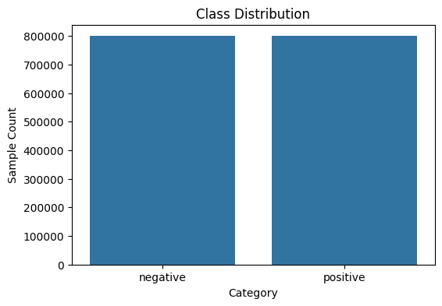
Observations from Dataset
01
02
Word Count of Tweets
Class Distribution
Most tweets are <150 chars & <30 words.
Balanced class distribution.

Slide 7
Data Preprocessing
Data Selection
Text Expansion and Tokenization
Retained only 'polarity' and 'text'
Expanded abbreviations, tokenized using NLTK.
Noise Removal
Removed tags, emojis, usernames, non- ASCII chars.

Slide 8
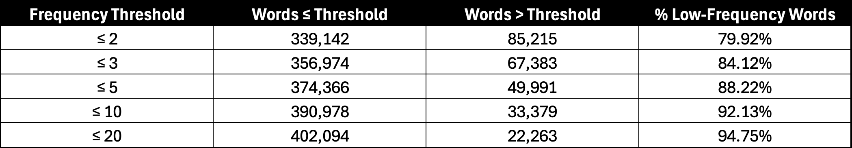
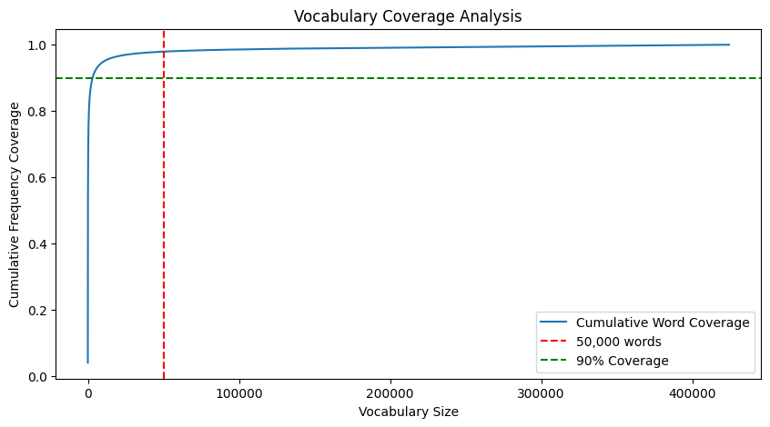
Data Review After Preprocessing
Word Selection
Top 50,000 most frequent words selected.
Balance Between Noise and Semantics
Balances noise removal and semantic coverage.

Slide 9
02
PART
Model Development

Slide 10
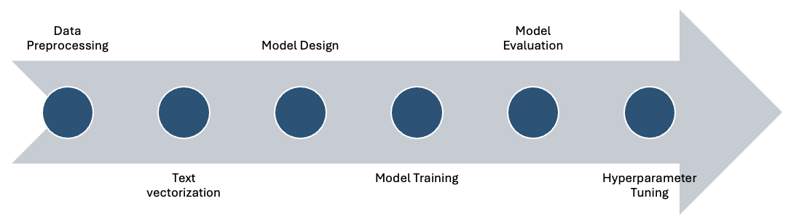
Logic Regression
Supervised machine learning algorithm for binary classification
RNN
Process sequential data by learning temporal dependencies
CNN
Extracts local features from text, effective for NLP and sequential tasks
BERT
Captures bidirectional context for robust NLP Tasks
Methodology

Slide 11
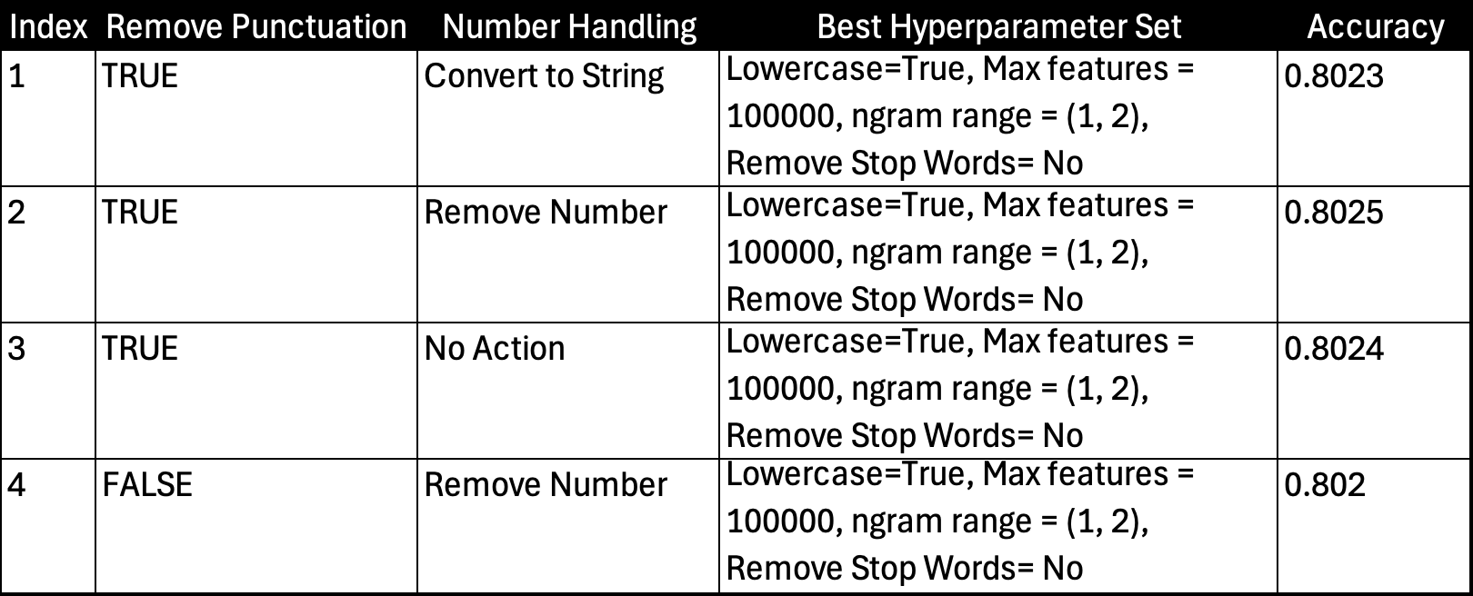
Machine Learning Based Approach
Switched to Logistic Regression with TF-IDF
Started with Naive Bayes for quick prototyping
Introduced regularization parameter C
Best Accuracy: 82.3%

Slide 12
Deep Learning – RNN, GRU, LSTM Approaches
Model Configuration Details
Configembed_dim=512, hidden_dim=256, layers=2.
Training Split
Bidirectional and Pooling
Train/Val/Test = 70/15/15.
Bidirectional=True, Max pooling.

Slide 13
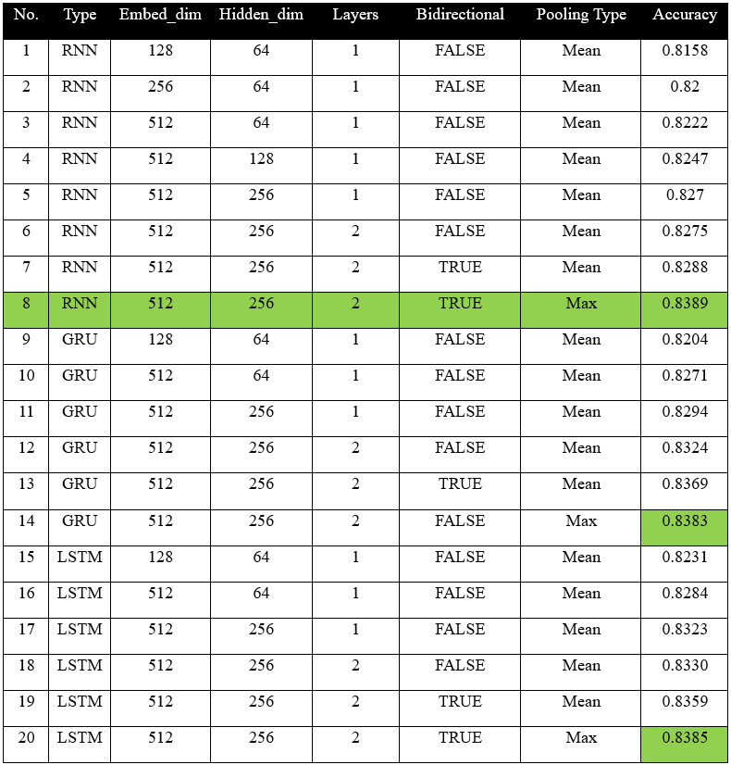
Deep Learning – RNN, GRU, LSTM Approaches
Model Performance
Results Accuracy ~84%, GRU & LSTM ≈ RNN.

Slide 14
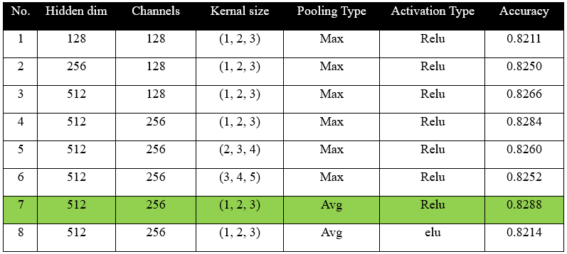
Deep Learning – CNN Approaches
Model Performance
Results Accuracy ~82.88%
underperforms RNN models
CNN Architecture
CNN captures local features.

Slide 15
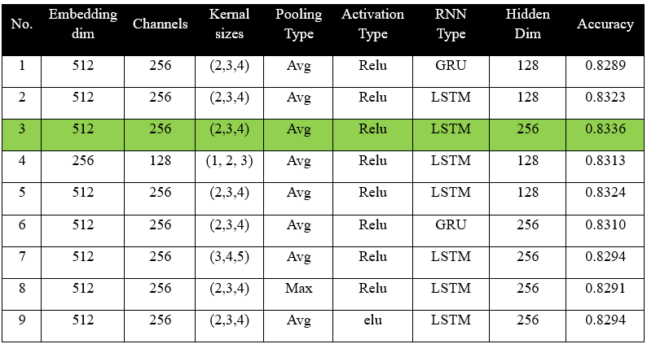
Deep Learning – CNN Approaches
Model Performance
Results Accuracy ~83.36%
still underperforms RNN-only models
Hybrid Model Architecture
Hybrid CNN + GRU/LSTM.

Slide 16
Pretrained Language Model – BERT Approaches
Size and Performance Issues with BERT
Advantages of DistilBERT
BERT too large → switched to DistilBERT.
40% smaller, 60% faster, minimal accuracy loss.
Training Optimization of withDistilBERT
Capped training at 5 epochs
Used GrapScaler for faster, memory efficient training

Slide 17

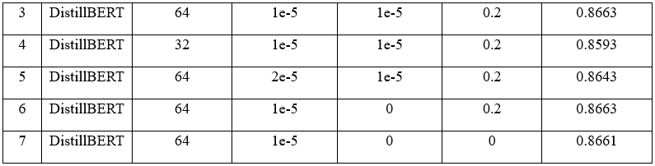
Pretrained Language Model – BERT Approaches
Model Performance
Results Accuracy ~86.63%
Best performing

Slide 18
Pretrained Language Model – BERT Approaches
TinyBERT Tested: faster, but lower accuracy

Slide 19
3
PART
Conclusion and Future Work

Slide 20

Model Comparison
”

Slide 21
Directions for Future Work
Exploration of Other Models
Data Augmentation Techniques
Try RoBERTa, ALBERT.
Apply data augmentation.
Hardware Acceleration
Use hardware acceleration.

Slide 22
010
PART
Q&A

